Slide 1
Influencing Behaviours Driving towards Safer, Healthier Society – An Insurance Fintech Solution
Team: Skalable_Fintech
Vedachalam M
Suresh Kumar S
Althaf A
Praveen Kumar V

Slide 2
Challenges to solve
Providing inputs to Insurance provider for better decision
Providing inputs to user for betterment (life-style, health)

Slide 3
Process Steps 1) Collect User Location Data using Mobile PowerApp Note: Consent from User to use and share privacy data. Data inputs would be collected to determine work, home location, mode of travel etc., for accuracy of recommendations 2) Provide periodic recommendations to user based on location tracking data. 3) Share travel, health visit, gym related data to Insurance Providers, to evaluate risk (hence an Insurance Fintech solution)

Slide 4
Sample Recommendations
Your on-road travel hours is more; Hope you are using a e-bike. These are the best selling e-bikes in your city
You have spent 20+ hours this week in a gym; here is a gift voucher for you …
You spent 80 hrs for shopping; time to look at e-shopping…we have new offers for you from: a, b, c
Your work-life balance is good; work location hours is 40%; Home: 20%; Recreation: 20%; Others: 20%

Slide 5
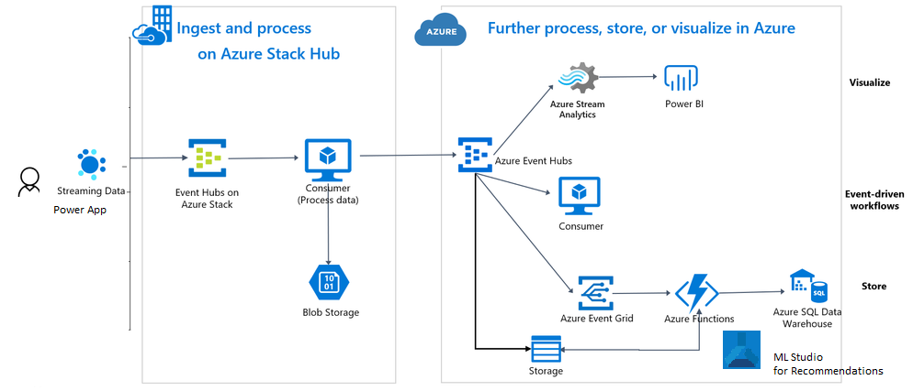

Architecture Diagram
Telco Generator
Azure Maps
Power apps

Slide 6
Data Flow
Mobile PowerApp
Azure Event Hub
Azure Storage + Azure Stream Analytics
Azure ML Studio
PBI reports for User for detailed view
Recommendation as Push Notification

